Slide 1
Domain Adaptation
Michal Baránek

Slide 2
What is domain adaptation
Form of transfer learning with access to target domain data
Allows us to use knowledge from source domain
Useful when target domain has only unlabeled data

Slide 3


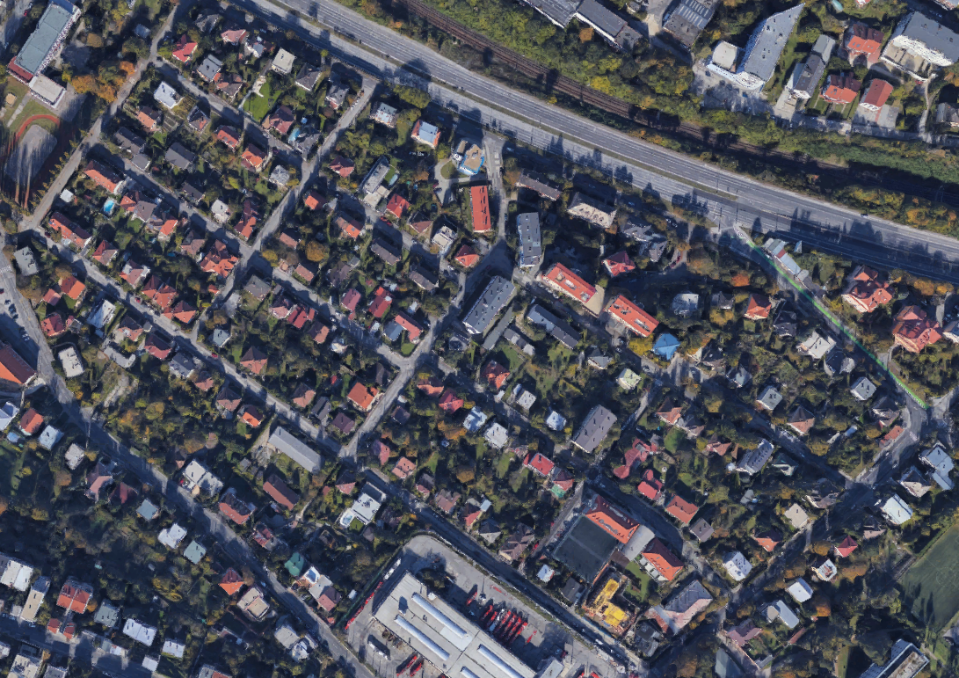
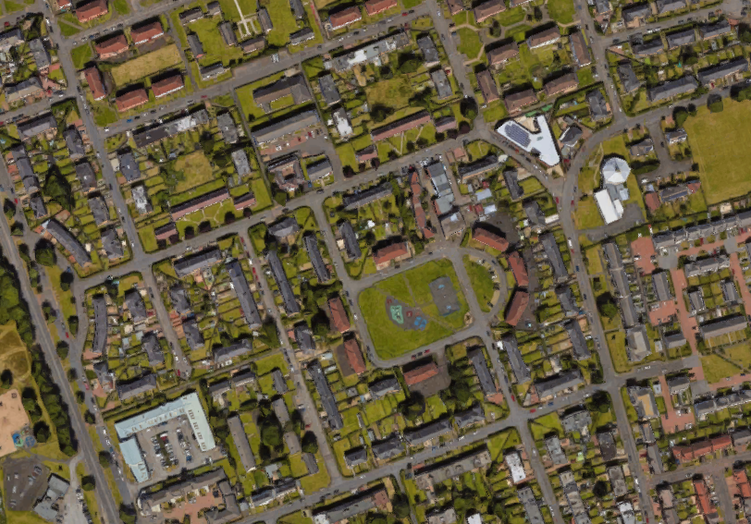
Common assumtions of domain adaptation
Source and target domain differ only in domain
There exists a single hypothesis with low error

